Slide 1
Worker Safety
2018

Slide 2
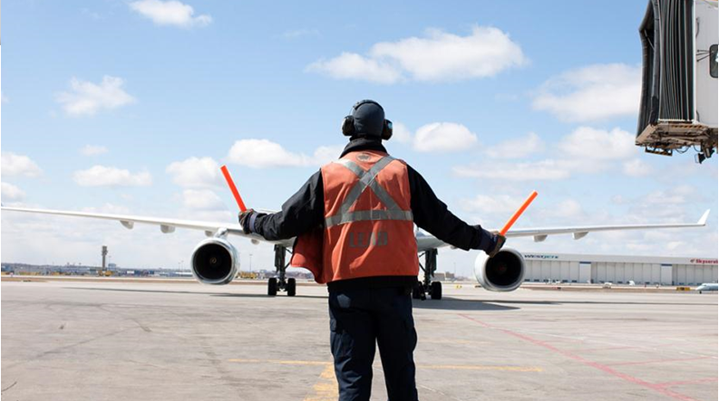

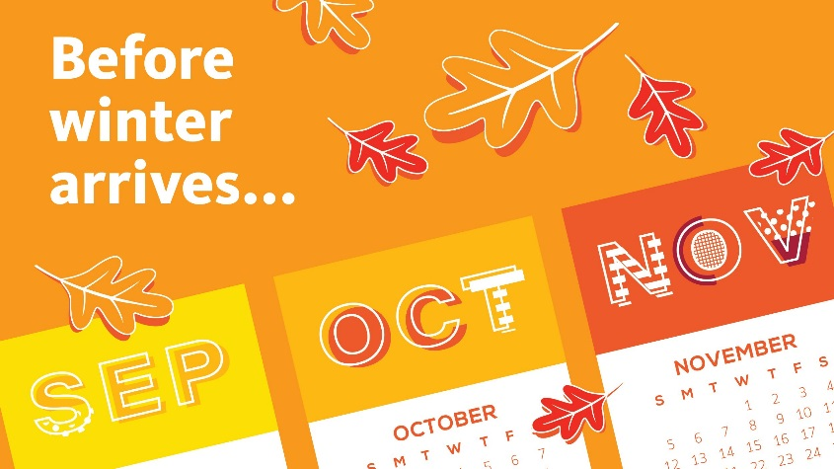
WORKER SAFETY – “Head to Toe”
Fatigue Management, Personal Protective Equipment & Winter Safety Tips

Slide 3

Personal Fatigue Management
Fatigue is a state of physical or mental weariness that results in reduced alertness. It is the result of inadequate quantity or quality of sleep.

Slide 4
DID YOU KNOW?
Being awake for 24 hours or more is equivalent to being legally too drunk to drive (Blood Alcohol Content = 0.10%)
Fatigue can have a negative impact on your personal health and family/social life
Being fatigued can make you a risk to your own safety, to your co-workers, and to others

Slide 5
Personal Fatigue Management
Acute Fatigue
Short term sleep loss due to heavy physical or mental work
Effects:
Short term
Reversed by sleep and relaxation
Chronic Fatigue
Constant severe state of tiredness
Effects:
Lasts longer than 6 months
Flu-like symptoms & not relived by rest
Reversed by managing symptoms with doctors

Slide 6
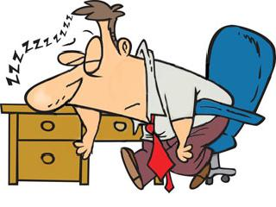
Signs of Fatigue
Tiredness
Sleepiness
Irritability
Depression
Loss of appetite
Digestive problems
Increased susceptibility to illness

Slide 7
Personal Fatigue Management
Fatigue has negative effects on the workplace that can lead to workplace incidents.
Reduced:
Decision making ability
Communication skills
Productivity and performance
Reaction time
Increased:
Tendency for risk taking
Errors in judgment
Sick time (absenteeism)
Incident rates

Slide 8

Adopt Good Sleeping Habits
Most people need 7-9 hours of sleep per day.
Implement a regular bedtime routine and schedule
If your shift changes, adjust your bedtime gradually
What can I do to manage fatigue?

Slide 9
Maintain a Healthy Lifestyle
Avoid dehydration and drink plenty of fluids; at least 2 liters per day
Eat right (low-fat, high-protein foods can increase alertness)
What can I do to manage fatigue?

Slide 10

Personal Protective Equipment
Personal Protective Equipment (PPE) refers to any clothing or equipment that is used by a worker in order to protect them from injury or illness

Slide 11
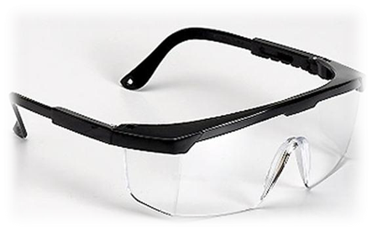
Types of PPE
Many jobs require PPE
Always wear the appropriate PPE for the hazards that you may encounter on the job or as required:
Eye Protection
Hearing Protection
Head Protection
Hand & Finger Protection
Foot Protection

Slide 12
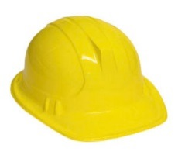
Head Protection
In Construction zones, hard hats are worn because of the potential for head injury.
Situations that could cause injury when working:
Below other workers or machinery
Around or under conveyor belts
Around exposed energized conductors
Where there may be overhead obstructions

Slide 13

Eye Protection
DID YOU KNOW?
In Canada:
700 Canadian workers sustain eye injuries every day on the job due to improper eye protection, resulting in lost time.
It is estimated that 90% of these injuries could be prevented with proper eye wear.

Slide 14
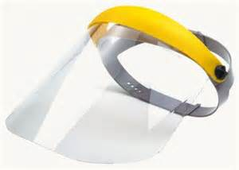
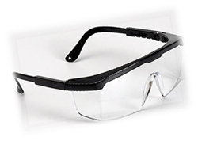
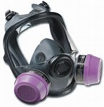
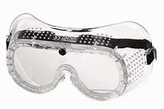
Eye Protection
Face Mask / Respirator
Safety Goggles
Safety Glasses

Slide 15

Eye Protection
Activities associated with wearing the appropriate level of eye protection:
Welding, cutting, and brazing
Sawing, grinding
Spray painting
Dusty environments
Chemical gases, vapours, or liquids
Sunlight or Harmful Light
Note: See your supervisor for job specific eyewear.

Slide 16
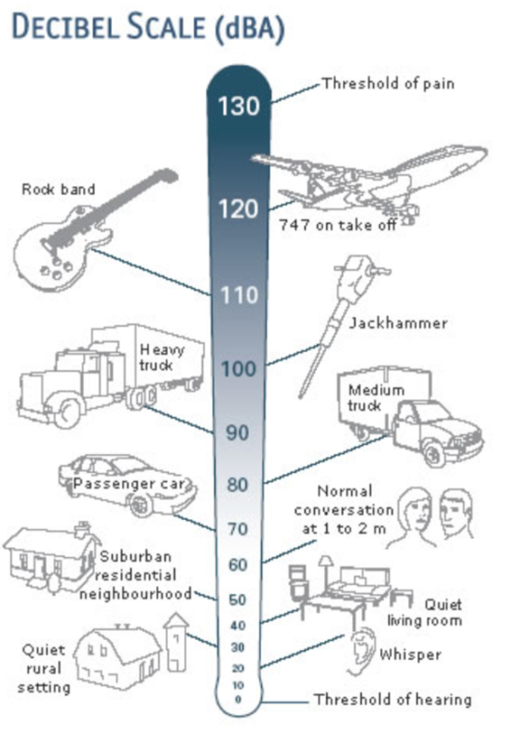
Hearing Protection
CAN YOU HEAR ME NOW?
HEARING LOSS PREVENTION: You don’t know what you’ve lost until it’s gone!
Sound levels of a jet engine range from 120dB – 140 dB!
To get the full benefit of hearing protection, they should be worn wherever noise hazards are present.

Slide 17
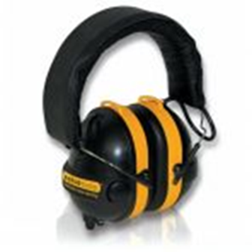

Hearing Protection
At the airport, there are certain areas that may require hearing protection.
Examples include (but not limited too):
Airside
Mechanical rooms
Generator rooms
Wearing your hearing protection in these areas will:
Reduce the amount of noise reaching the ears
Reduce the risk from hearing loss

Slide 18
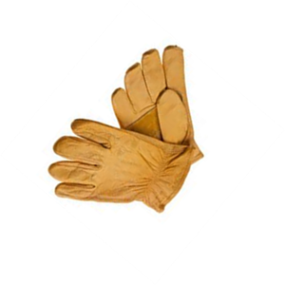
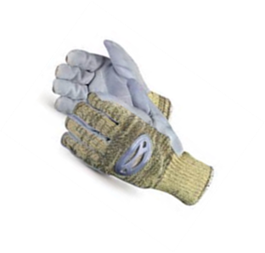
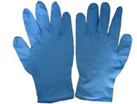
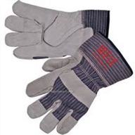
Hand & Finger Protection
Gloves protect hands and forearms from:
Cuts
Abrasions
Burns
Puncture Wounds
Contact with hazardous chemicals
Some electric shocks
Blood borne pathogen diseases
If the job task requires wearing gloves, wear the right gloves for the right job!

Slide 19
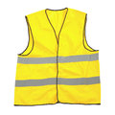
Stand out from all the rest,
WEAR YOUR SAFETY VEST!
ALL personnel are required to wear a high visibility, reflective safety vest when in certain areas.
Here at YYC, safety vests are required whenever you are in the baggage halls or out on airside.

Slide 20
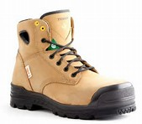
Foot Protection
Safety-toed footwear is worn to prevent crushed toes when working around heavy equipment or potential falling objects
Safety footwear must be CSA certified (green patch)
Safety boots also provide protection from stepping on sharp objects and some di-electric protection
Inclement weather can create slipping hazards, so be safety conscious in footwear!

Slide 21
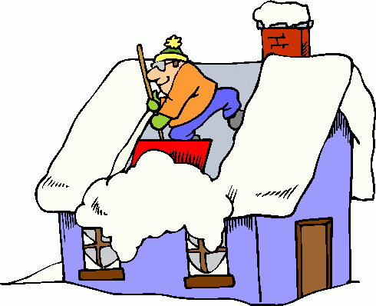
Winter Safety Tips
Starting at home
  Identify hazards
  Keep your walks shoveled
  Pay attention to ladder safety
  Dress in layers according to conditions
  Get your rest and stay hydrated

Slide 22
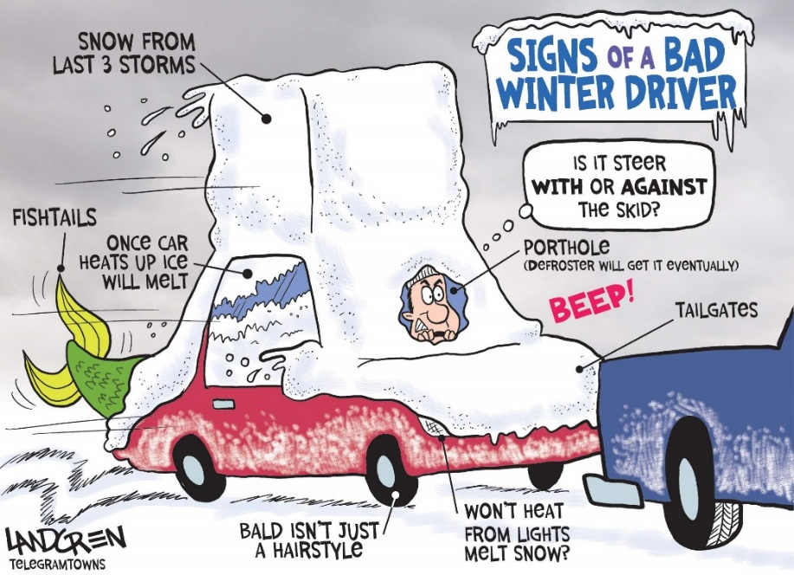
Winter Safety Tips
On your way into work
  Is your vehicle ready for winter
  Allow more time for traveling
  Adjust your driving habits
  Do not be a distracted driver
  Use three (3) points of contact
  Follow appropriate wayfinding

Slide 23
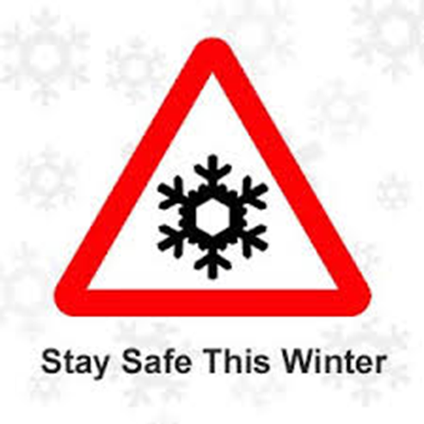
Winter Safety Tips
While at work
  Maintain situational awareness
  Watch for obstacles
  Allow more time to complete tasks
  Adjusted your walking pace and stride
  Wear appropriate winter gear and footwear
  Use maintained pathways that are well lit, have even surfaces, and are shoveled and salted
  Use three (3) points of contact (stairs, ladders, GSE)
  Report hazards and incidents immediately

Slide 24
REMINDER: Safety Reporting Methods
Airport Emergencies:
911 and then 403-735-(1300)
Airport Non-Emergencies:
YYC’s Integrated Operations Centre (IOC)
403-735-(1300)

