Slide 1
Environmental Protection at YYC
2018

Slide 2
Introduction
Canada’s airports are committed to being leaders in environmental protection;
Within their operations, we minimize the impact on the environment by implementing processes & investing in equipment & technology;
Airports are regulated by TC & governed by a number of federal, provincial and municipal laws to ensure airports are safe & efficient while protecting the environment;
Protecting quality of air, water and land is the core objective of environmental programs at YYC.

Slide 3
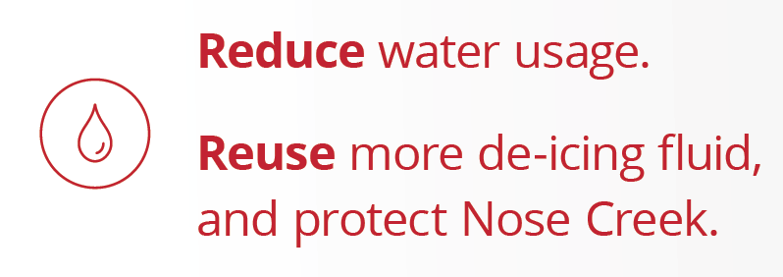
Environmental Goals at YYC

Slide 4
Construction Installation Permits
Environmental management is integrated into planning, design, construction & operation of all new infrastructure;
Construction and development is required to follow environmental practices related to:
Erosion reduction;
Habitat and wildlife protection;
Air emissions and dust reduction;
Stormwater collection and treatment;
Spill preparedness; and
Safe management/disposal of waste.

Slide 5
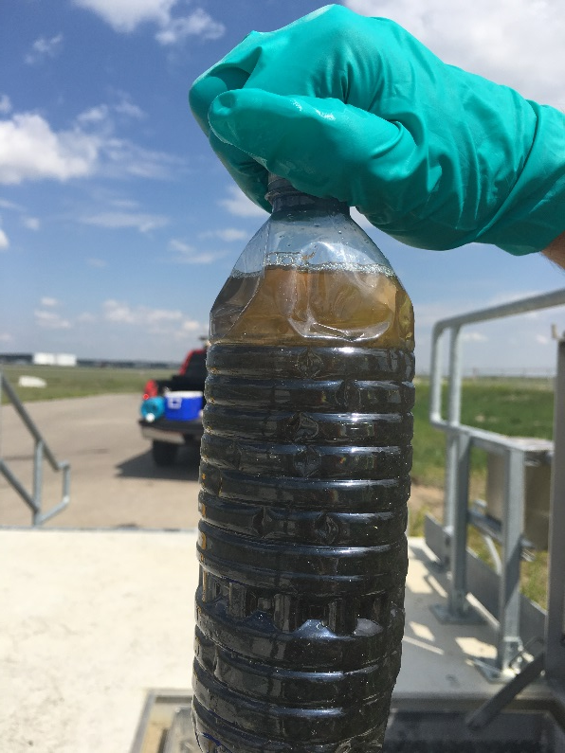
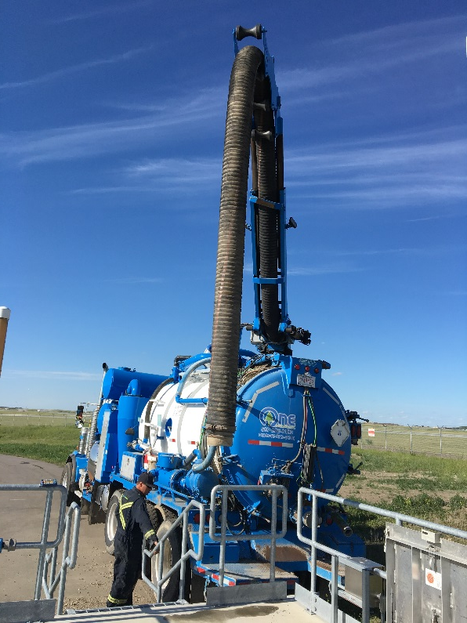
Spill Response and Reporting
Spills involving fuel or hazardous substances can affect surface water, soil and groundwater;
They can also cause fires or explosions, and be harmful to human health;
YYC has a spill response and reporting policy and SOP;
The spiller takes responsibility for cleanup.

Slide 6
Glycol Management
YYC uses 5-7 million L of Glycol per year and 24% is recovered and recycled;
Glycol is the single biggest regulated stormwater constituent generated at YYC;
Despite industry-leading efforts for recycling and recovery, safe disposal of glycol costs YYC $300,000 to $600,000 per year in bylaw charges to the City of Calgary.

Slide 7
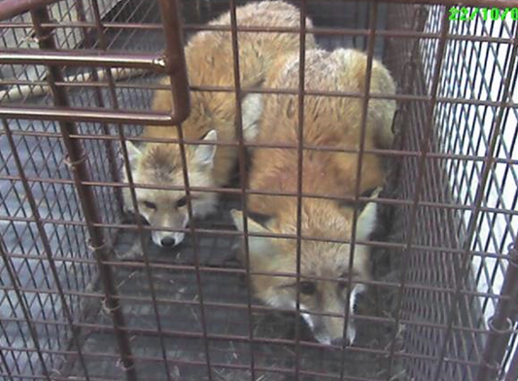
Habitat Management & Wildlife
Airport lands are managed to discourage or prevent specific wildlife from potentially coming into contact with aircraft.
Although birds are a primary concern, all mammals are encompassed in the program.
There are anywhere from 5 to 50 wildlife strikes per year.
YYC implements ongoing monitoring and wildlife control to reduce the risk to aircraft and species in our local ecosystem.

Slide 8
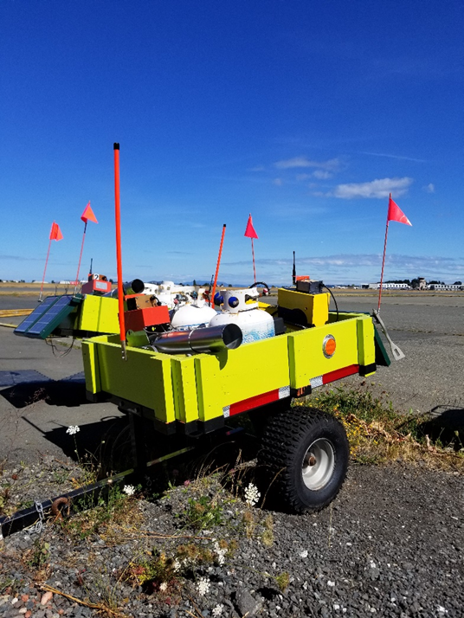
Habitat Management & Wildlife
YYC discourage birds from feeding in high-risk zones using various non-lethal techniques, such as:
Draining airside fields to prevent flooding and to discourage waterfowl and gulls from frequenting the area;
Pyrotechnics and bird cannons to scare or disperse wildlife;
Trap and transport raptors away from airfields; and
Visual deterrents.
Bird canons

Slide 9
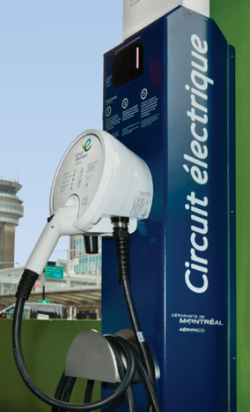
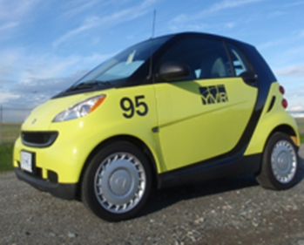
Air Quality & Emissions
Airports implement actions to reduce emissions from airports or stakeholders
Examples of actions include:
LED lighting
Installation of pre-conditioned air (PCA) and ground power units (GPU) at bridges, which minimize use of fossil fuel equipment
Restrictions on use of fossil fuel equipment in baggage rooms
Electric vehicles
Work with municipalities to improve ground transportation
Greening of taxi fleets
Electric Vehicle Charging Stations
Idle-free programs
Use of biofuel

Slide 10
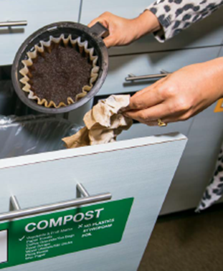
Waste & Recycling
Airports identify and mitigate worker health and safety risks by ensuring good training on how to use, store and work with chemicals
Airports also divert other materials such as bottles, paper, glass, metal & plastics
Examples of waste-reduction projects include:
Organic waste diversion
Construction material reuse and recycling
Materials recycling
Sustainable printing

Slide 11
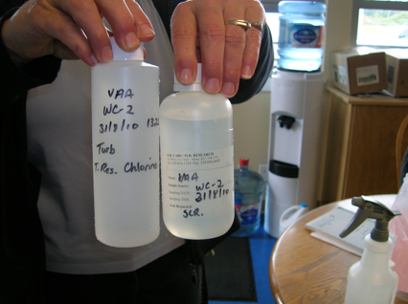
Potable Water Testing
Specific points are tested at airports to monitor for any variances to potable water used by the public and airport staff
By monitoring regularly, airports are able to proactively identify any potential issues with potable water and reduce the chance of illness or related problems that would result.

Slide 12
Enviromental Safety
REMINDER: General Safety Reporting Methods
Airport Emergencies:
911 and then 403-735-(1300)
Airport Non-Emergencies:
YYC’s Integrated Operations Centre (IOC)
403-735-(1300)

